Slide 1
Deadlock
Course Instructor: Nausheen Shoaib

Slide 2
Deadlock
A set of processes is deadlocked when each process in the set is blocked awaiting an event that can only be triggered by another blocked process in the set
Typically involves processes competing for the same set of resources
No efficient solution
Notes:
A set of processes is deadlocked when each process in the set is blocked awaiting an event that can only be triggered by another blocked process in the set
typically processes are waiting the freeing up of some requested resource.
Deadlock is permanent because none of the events is ever triggered.
Unlike other problems in concurrent process management, there is no efficient solution in the general case.

Slide 3

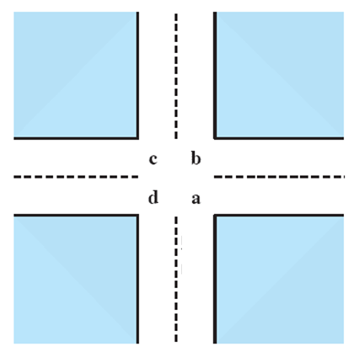
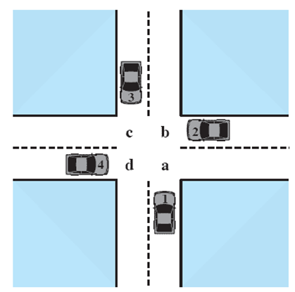



Potential Deadlock
I need quad C and B
I need quad B and C
I need quad A and B
I need quad D and A
Notes:
Animated Slide
Click 1 Cars approach intersection
Then Cars announce their resource needs
All deadlocks involve conflicting needs for resources by two or more processes. A common example is the traffic deadlock.
The typical rule of the road in the United States is that a car at a four-way stop should defer to a car immediately to its right.
This rule works if there are only two or three cars at the intersection.
If all four cars arrive at about the same time, each will refrain from entering the intersection, this causes a potential deadlock.
The deadlock is only potential, not actual, because the necessary resources are available for any of the cars to proceed.
If one car eventually does proceed, it can do so.

Slide 4
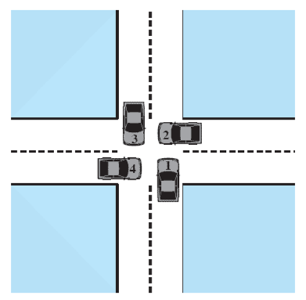
Actual Deadlock
HALT until D is free
HALT until C is free
HALT until B is free
HALT until A is free
Notes:
Animated Slide
Click 1 Cars move to deadlock
Then Cars announce their resource need
But if all four cars ignore the rules and proceed (cautiously) into the intersection at the same time, then each car seizes one resource (one quadrant) but cannot proceed because the required second resource has already been seized by another car.
This is an actual deadlock.

Slide 5
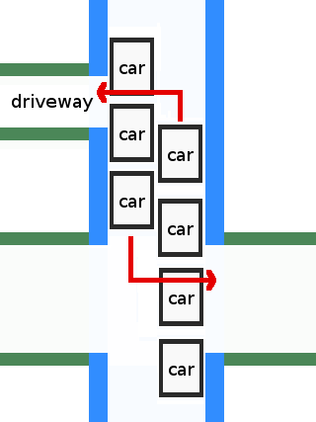
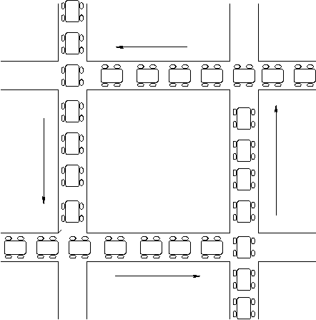
Deadlock Examples

Slide 6
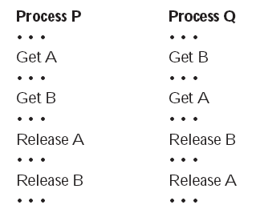
Two Processes P and Q
Lets look at this with two processes P and Q
Each needing exclusive access to a resource A and B for a period of time
Notes:
Each process needs exclusive use of both resources for a certain period of time.
Two processes, P and Q, have the following general form:

Slide 7
Resource Categories
Two general categories of resources:
Reusable
can be safely used by only one process at a time and is not depleted by that use.
Consumable
one that can be created (produced) and destroyed (consumed).

Slide 8
Reusable Resources
Such as:
Processors, I/O channels, main and secondary memory, devices, and data structures such as files, databases, and semaphores
Deadlock occurs if each process holds one resource and requests the other

Slide 9
Example of Reuse Deadlock
Consider two processes that compete for exclusive access to a disk file D and a tape drive T.
Deadlock occurs if each process holds one resource and requests the other.

Slide 10
Consumable Resources
Such as Interrupts, signals, messages, and information in I/O buffers
Deadlock may occur if a Receive message is blocking
May take a rare combination of events to cause deadlock

Slide 11
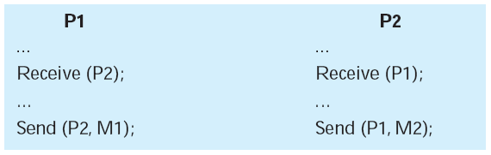
Example of Deadlock
Consider a pair of processes, in which each process attempts to receive a message from the other process and then send a message to the other process
Notes:
Deadlock occurs if the Receive is blocking (i.e., the receiving process is blocked until the message is received).
A design error is the cause of the deadlock.
Such errors may be quite subtle and difficult to detect.
Furthermore, it may take a rare combination of events to cause the deadlock; thus a program could be in use for a considerable period of time, even years, before the deadlock actually occurs.

Slide 12
Roadmap
Principles of Deadlock
Dining Philosophers Problem
Deadlock Prevention
Deadlock Avoidance
Deadlock Detection
An Integrated deadlock strategy
Concurrency Mechanisms in UNIX, Linux, Solaris and Windows

Slide 13
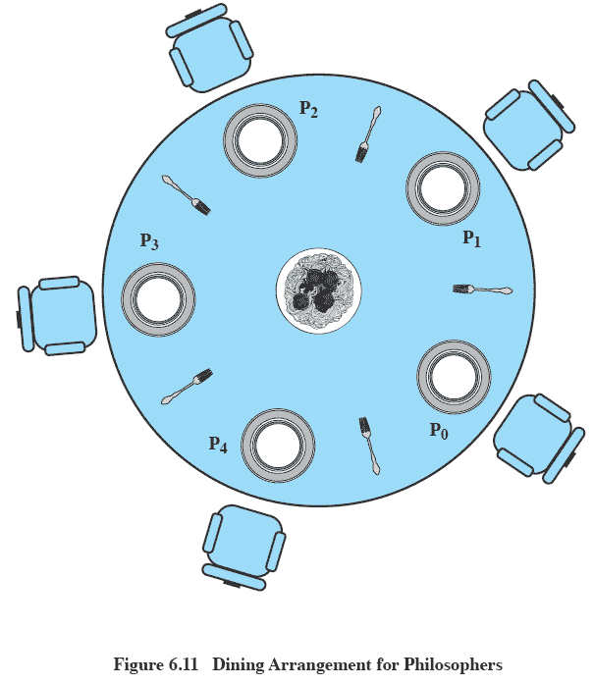
Dining Philosophers Problem: Scenario
Notes:
Five philosophers live in a house, where a table is laid for them.
The life of each philosopher consists principally of thinking and eating, and through years of thought, all of the philosophers had agreed that the only food that contributed to their thinking efforts was spaghetti.
Due to a lack of manual skill, each philosopher requires two forks to eat spaghetti.
A philosopher wishing to eat goes to his or her assigned place at the table and, using the two forks on either side of the plate, takes and eats some spaghetti.

Slide 14
The Problem
Devise a ritual (algorithm) that will allow the philosophers to eat.
No two philosophers can use the same fork at the same time (mutual exclusion)
No philosopher must starve to death (avoid deadlock and starvation … literally!)

Slide 15
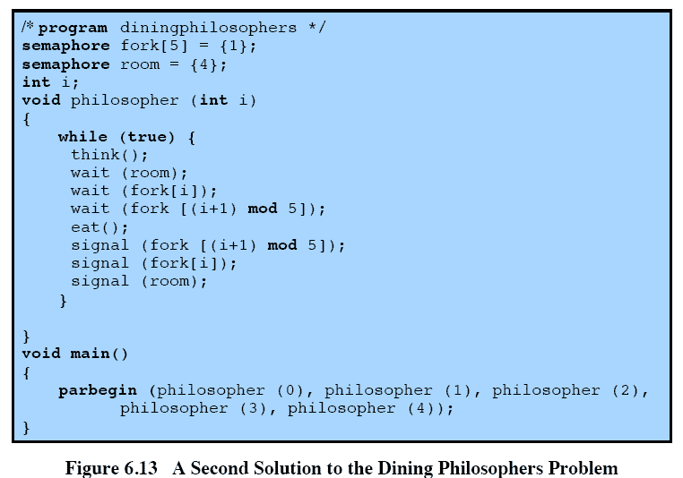
Avoiding deadlock
Notes:
We could consider adding an attendant who only allows four philosophers at a time into the dining room.
With at most four seated philosophers, at least one philosopher will have access to two forks.
This slide shows such a solution, again using semaphores. This solution is free of deadlock and starvation.

Slide 16
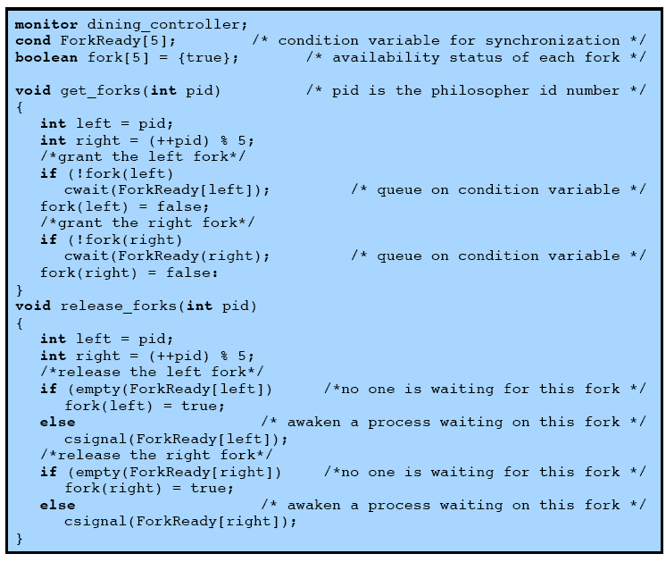
Solution using Monitors
Notes:
This slide shows a solution to the dining philosophers problem using a monitor – and is continued on next slide
A vector of five condition variables is defined, one condition variable per fork.
These condition variables are used to enable a philosopher to wait for the availability of a fork.
In addition, there is a Boolean vector that records the availability status of each fork (true means the fork is available).
The monitor consists of two procedures.
The get_forks procedure is used by a philosopher to seize his or her left and right forks.
If either fork is unavailable, the philosopher process is queued on the appropriate condition variable.
This enables another philosopher process to enter the monitor.
The release-forks procedure is used to make two forks available.
Note that the structure of this solution is similar to that of the semaphore solution proposed in Figure 6.12.
In both cases, a philosopher seizes first the left fork and then the right fork.
Unlike the semaphore solution, this monitor solution does not suffer from deadlock, because only one process at a time may be in the monitor.
For example, the first philosopher process to enter the monitor is guaranteed that it can pick up the right fork after it picks up the left fork before the next philosopher to the right has a chance to seize its left fork, which is this philosopher’s right fork.

Slide 17
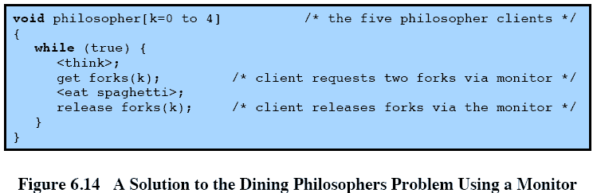
Monitor solution cont.

Slide 18
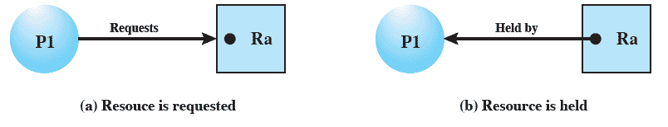
Resource Allocation Graphs
Directed graph that depicts a state of the system of resources and processes
Notes:
A graph edge directed from a process to a resource indicates a resource that has been requested by the process but not yet granted.
Within a resource node, a dot is shown for each instance of that resource.
A graph edge directed from a reusable resource node dot to a process indicates a request that has been granted

Slide 19
Conditions for possible Deadlock
Mutual exclusion (non-sharable resources)
Only one process may use a resource at a time
Hold-and-wait
A process may hold allocated resources while awaiting assignment of others
No pre-emption
No resource can be forcibly removed from a process holding it
Notes:
All three must be present for deadlock to occur.

Slide 20
Actual Deadlock Requires …
All previous 3 conditions plus:
Circular wait
A closed chain of processes exists, such that each process holds at least one resource needed by the next process in the chain
Notes:
This is actually a potential consequence of the first three.
Given that the first three conditions exist, a sequence of events may occur that lead to an unresolvable circular wait.
The unresolvable circular wait is in fact the definition of deadlock.
The circular wait listed as condition 4 is unresolvable because the first three conditions hold.
Thus, the four conditions, taken together, constitute necessary and sufficient conditions for deadlock.

Slide 21
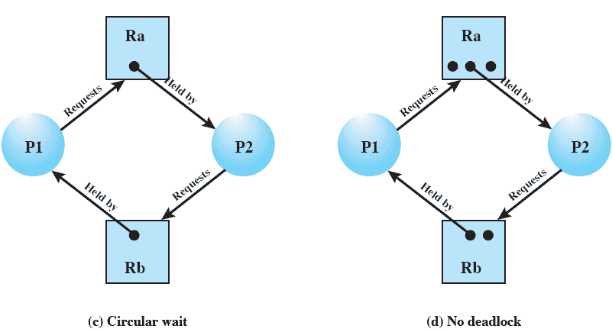
Resource Allocation Graphs of deadlock

Slide 22
Resource Allocation Graphs of deadlock
Deadlocks can be described more precisely in terms of a directed graph called
a system resource-allocation graph

Slide 23
Resource Allocation Graphs of deadlock
Resource instances:
◦ One instance of resource type R1
◦ Two instances of resource type R2
◦ One instance of resource type R3
◦ Three instances of resource type R4
Process states:
◦ Process P1 is holding an instance of resource
type R2 and is waiting for an instance of
resource type R1.
◦ Process P2 is holding an instance of R1 and an
instance of R2 and is waiting for an instance of R3.
◦ Process P3 is holding an instance of R3.

Slide 24
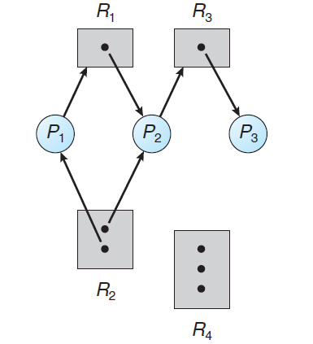
Resource Allocation Graphs of deadlock

Slide 25
Dealing with Deadlock
Three general approaches exist for dealing with deadlock.
Prevent deadlock
Avoid deadlock
Detect Deadlock
Notes:
Three general approaches exist for dealing with deadlock.
prevent deadlock
adopt a policy that eliminates one of the conditions (conditions 1 through 4).
avoid deadlock
by making the appropriate dynamic choices based on the current state of resource allocation.
detect the presence of deadlock
(conditions 1 through 4 hold) and take action to recover.
We discuss each of these approaches in turn.

Slide 26
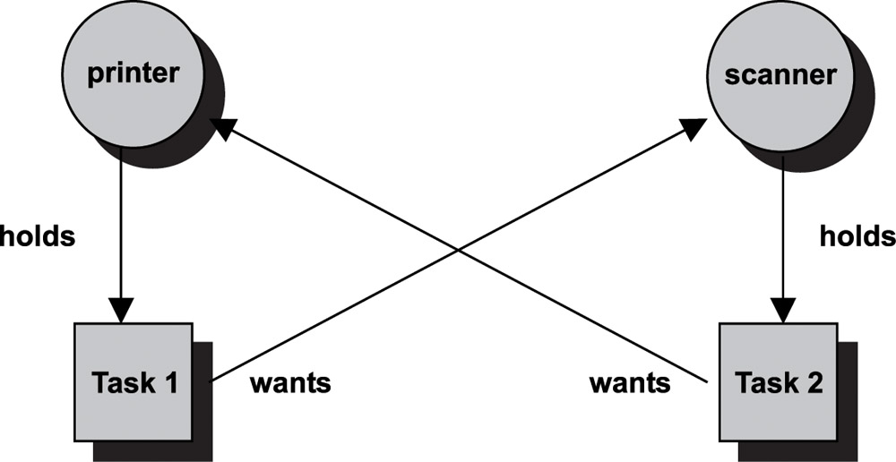
Dealing with Deadlock

Slide 27
Deadlock Prevention Strategy
Design a system in such a way that the possibility of deadlock is excluded.
Two main methods
Indirect – prevent one of the three necessary conditions from occurring
Direct – prevent circular waits
Notes:
Deadlock prevention is strategy simply to design a system in such a way that the possibility of deadlock is excluded.
We can view deadlock prevention methods as falling into two classes.
indirect method of deadlock prevention is to prevent the occurrence of one of the three necessary conditions listed previously (items 1 through 3).
direct method of deadlock prevention is to prevent the occurrence of a circular wait (item 4).
We now examine techniques related to each of the four
conditions.

Slide 28
Deadlock Prevention Conditions
Mutual Exclusion
Hold and Wait
Require a process request all of its required resources at one time
No Preemption
Process must release resource and request again
OS may preempt a process to require it releases its resources
Circular Wait
Define a linear ordering of resource types
Notes:
Mutual Exclusion
The first of the four listed conditions cannot be disallowed (in general).
If access to a resource requires mutual exclusion, then mutual exclusion must be supported by the OS.
Some resources, such as files, may allow multiple accesses for reads but only exclusive access for writes.
Even in this case, deadlock can occur if more than one process requires write permission.
Hold an Wait
Can be prevented by requiring that a process request all of its required resources at one time and blocking the process until all requests can be granted simultaneously.
This approach is inefficient in two ways.
1) a process may be held up for a long time waiting for all of its resource requests to be filled, when in fact it could have proceeded with only some of the resources.
resources allocated to a process may remain unused for a considerable period, during which time they are denied to other processes.
Another problem is that a process may not know in advance all of the resources that it will require.
There is also the practical problem created by the use of modular programming or a multithreaded structure for an application.
An application would need to be aware of all resources that will be requested at all levels or in all modules to make the simultaneous request.

Slide 29
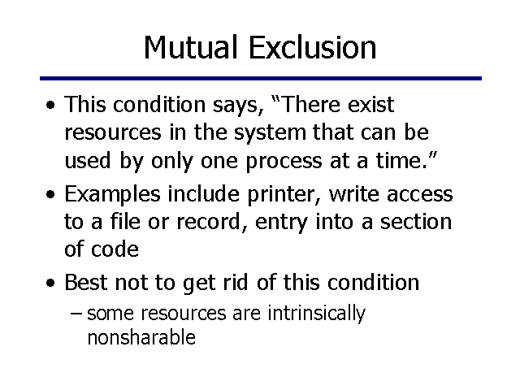
Deadlock Prevention Conditions

Slide 30
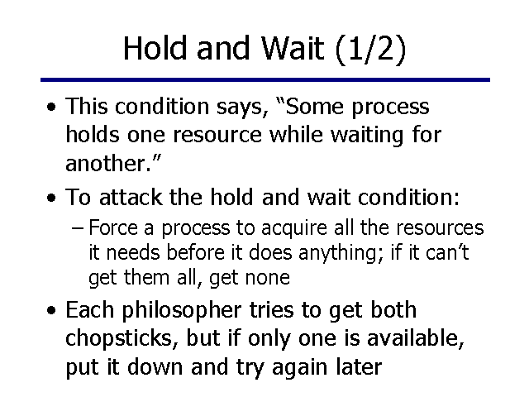
Deadlock Prevention Conditions

Slide 31
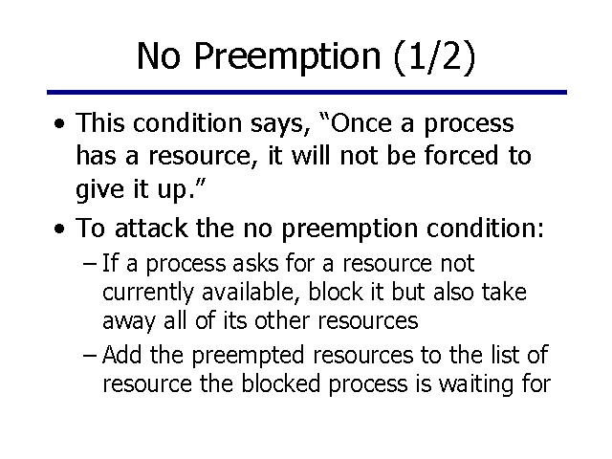
Deadlock Prevention Conditions

Slide 32
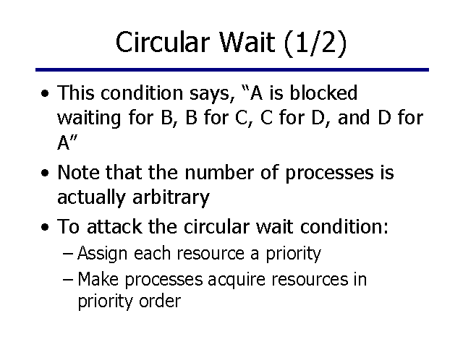
Deadlock Prevention Conditions

Slide 33
Deadlock Avoidance
A decision is made dynamically whether the current resource allocation request will, if granted, potentially lead to a deadlock
Requires knowledge of future process requests
Notes:
Deadlock avoidance allows the three necessary conditions
but makes judicious choices to assure that the deadlock point is never reached.
Avoidance allows more concurrency than prevention.
With deadlock avoidance, a decision is made dynamically whether the current resource allocation request will, if granted, potentially lead to a deadlock.
Deadlock avoidance requires knowledge of future process resource requests.

Slide 34
Two Approaches to Deadlock Avoidance
Process Initiation Denial
Resource Allocation Denial

Slide 35
Process Initiation Denial
A process is only started if the maximum claim of all current processes plus those of the new process can be met.
Not optimal,
Assumes the worst: that all processes will make their maximum claims together.
Notes:
A process is only started if the maximum claim of all current processes plus those of the new process can be met.
This strategy is hardly optimal, because it assumes the worst:
that all processes will make their maximum claims together.

Slide 36
Resource Allocation Denial
Referred to as the banker’s algorithm
A strategy of resource allocation denial
Consider a system with fixed number of resources
State of the system is the current allocation of resources to process
Safe state is where there is at least one sequence that does not result in deadlock
Unsafe state is a state that is not safe
Notes:
Movie button goes to http://gaia.ecs.csus.edu/~zhangd/oscal/Banker/Banker.html

Slide 37
Basic Facts for deadlock avoidance
If a system is in safe state ⇒ no deadlocks
If a system is in unsafe state ⇒ possibility of deadlock
Avoidance ⇒ ensure that a system will never enter an unsafe state.

Slide 38
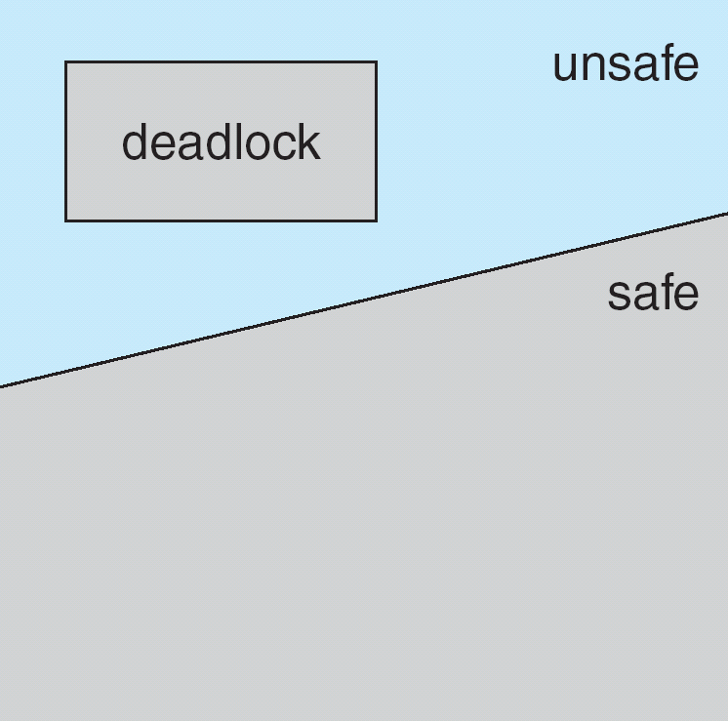
Safe, Unsafe, Deadlock State

Slide 39
Banker’s Algorithm
Multiple instances
Each process must a priori claim maximum use
When a process requests a resource it may have to wait
When a process gets all its resources it must return them in a finite amount of time

Slide 40
Data Structures for the Banker’s Algorithm
Let n = number of processes, and m = number of resources types.
Available: Vector of length m. If available [j] = k, there are k instances of resource type R_{j} available
Max: n x m matrix. If Max [i,j] = k, then process P_{i} may request at most k instances of resource type R_{j}
Allocation: n x m matrix. If Allocation[i,j] = k then P_{i} is currently allocated k instances of R_{j}
Need: n x m matrix. If Need[i,j] = k, then P_{i} may need k more instances of R_{j} to complete its task
Need [i,j] = Max[i,j] – Allocation [i,j]

Slide 41
Safety Algorithm
1. Let Work and Finish be vectors of length m and n, respectively. Initialize:
Work = Available
Finish [i] = false for i = 0, 1, …, n- 1
2. Find an i such that both:
(a) Finish [i] = false
(b) Need_{i} ≤ Work
If no such i exists, go to step 4
3. Work = Work + Allocation_{i} Finish[i] = true go to step 2
4. If Finish [i] == true for all i, then the system is in a safe state

Slide 42
Resource-Request Algorithm for Process P_{i}
Request_{i} = request vector for process P_{i}. If Request_{i} [j] = k then process P_{i} wants k instances of resource type R_{j}
1. If Request_{i} ≤ Need_{i} go to step 2. Otherwise, raise error condition, since process has exceeded its maximum claim
2. If Request_{i} ≤ Available, go to step 3. Otherwise P_{i} must wait, since resources are not available
3. Pretend to allocate requested resources to P_{i} by modifying the state as follows:
Available = Available – Request_{i};
Allocation_{i} = Allocation_{i} + Request_{i};
Need_{i} = Need_{i} – Request_{i};
If safe ⇒ the resources are allocated to P_{i}
If unsafe ⇒ P_{i} must wait, and the old resource-allocation state is restored

Slide 43
Example of Banker’s Algorithm
Discussed in Class

Slide 44
Deadlock Detection
Allow system to enter deadlock state
Detection algorithm
Recovery scheme

Slide 45
Single Instance of Each Resource Type
Maintain wait-for graph
Nodes are processes
P_{i} → P_{j} if P_{i} is waiting for P_{j}
Periodically invoke an algorithm that searches for a cycle in the graph. If there is a cycle, there exists a deadlock
An algorithm to detect a cycle in a graph requires an order of n² operations, where n is the number of vertices in the graph

Slide 46
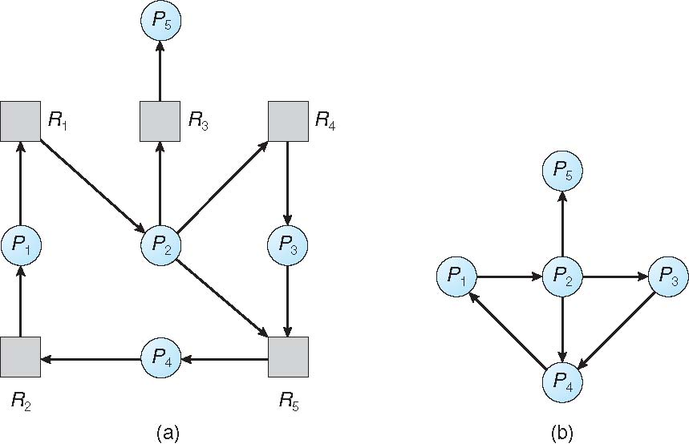
Resource-Allocation Graph and Wait-for Graph
Resource-Allocation Graph
Corresponding wait-for graph

Slide 47
Detection Algorithm
1. Let Work and Finish be vectors of length m and n, respectively Initialize:
(a) Work = Available
(b) For i = 1,2, …, n, if Allocation_{i} ≠ 0, then Finish[i] = false; otherwise, Finish[i] = true
2. Find an index i such that both:
(a) Finish[i] == false
(b) Request_{i} ≤ Work
If no such i exists, go to step 4

Slide 48
Detection Algorithm (Cont.)
3. Work = Work + Allocation_{i} Finish[i] = true go to step 2
4. If Finish[i] == false, for some i, 1 ≤ i ≤ n, then the system is in deadlock state. Moreover, if Finish[i] == false, then P_{i} is deadlocked

Slide 49
Example of Detection Algorithm
Five processes P₀ through P₄; three resource types A (7 instances), B (2 instances), and C (6 instances)
Snapshot at time T₀:
Allocation Request Available
A B C A B C A B C
P₀ 0 1 0 0 0 0 0 0 0
P₁ 2 0 0 2 0 2
P₂ 3 0 3 0 0 0
P₃ 2 1 1 1 0 0
P₄ 0 0 2 0 0 2
Sequence <P₀, P₂, P₃, P₁, P₄> will result in Finish[i] = true for all i

Slide 50
Example (Cont.)
P₂ requests an additional instance of type C
Request
A B C
P₀ 0 0 0
P₁ 2 0 2
P₂ 0 0 1
P₃ 1 0 0
P₄ 0 0 2
State of system?
Can reclaim resources held by process P₀, but insufficient resources to fulfill other processes; requests
Deadlock exists, consisting of processes P₁, P₂, P₃, and P₄

Slide 51
Recovery from Deadlock: Process Termination
Abort all deadlocked processes
Abort one process at a time until the deadlock cycle is eliminated
In which order should we choose to abort?
Priority of the process
How long process has computed, and how much longer to completion
Resources the process has used
Resources process needs to complete
How many processes will need to be terminated
Is process interactive or batch?

Slide 52
Recovery from Deadlock: Resource Preemption
Selecting a victim – minimize cost
Rollback – return to some safe state, restart process for that state
Starvation – same process may always be picked as victim, include number of rollback in cost factor

